Slide 1
Objects - Instances of Classes

Slide 2
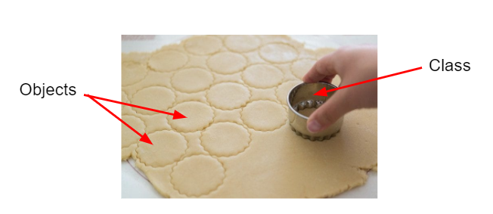
Classes and Objects

Slide 3
Classes and Objects
Objects are instances of classes.
Class
Human
Fruit
Animal
Object
Man, Woman, Child
Banana, Apple, Peach
Cat, Dog, Bear, etc.

Slide 4
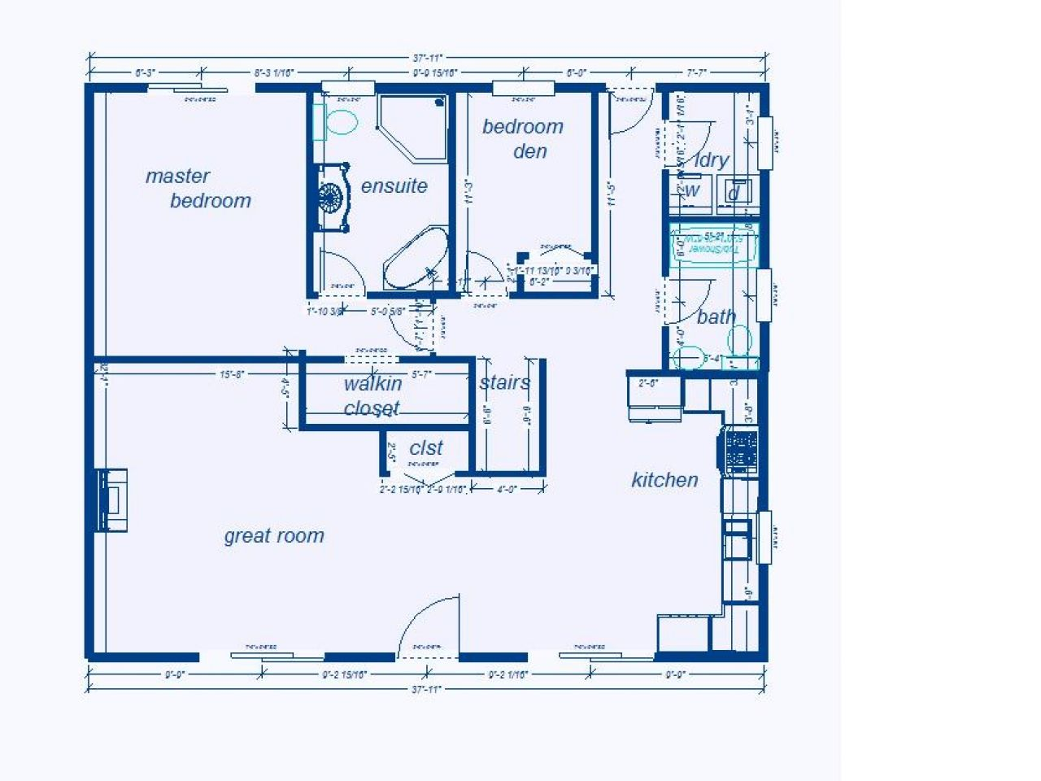

Class
Object

Slide 5
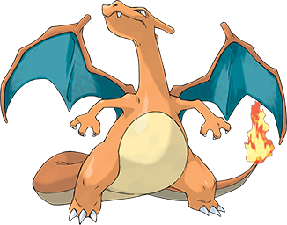

Class
Object

Slide 6
Class
Object
String
String greeting = “Hello world!”
String favoriteClass = “AP Computer Science”
String bestTeacher = “Ms. Molina”
Notes:
Car Example
4 Door Sedan -> Three different instances of that sedan

Slide 7
Attributes (instance variable) and Behaviors (methods)
An attribute or instance variable is data the object knows about itself. For example a turtle object knows the direction it is facing or its color.
A behavior or method is something that an object can do. For example a turtle object can go forward 100 pixels.

Slide 8
Classes and Objects
CLASS | OBJECT
A class is a blueprint from which you can create the instance, i.e., objects. | An object is the instance of the class, which helps programmers to use variables and methods from inside the class.
Classes have logical existence. | Objects have a physical existence.
A class doesn't take any memory spaces when a programmer creates one. (The “idea” of a cat) | An object takes memory when a programmer creates one. (A real, live cat)
The class has to be declared only once. (i.e. “Cat”) | Objects can be declared several times depending on the requirement. (i.e. “Buttons”, “Mr. Bigglesworth”, “Garfield”)

Slide 9
Classes and Objects
import java.util.*; import java.awt.*; public class TurtleTest { public static void main(String[] args) { World habitat = new World(300,300); Turtle yertle = new Turtle(habitat); int yertlesWeight = yertle.weight; System.out.println("Yertle's weight is " + yertlesWeight); yertle.forward(); yertle.turnLeft(); yertle.forward(); } }
Class: World
Object: habitat
Class: Turtle
Object: yertle

Slide 10
Object Variable Declaration
<variable name> = new <Class name> (<parameter1>, <parameter2>, …);
variable name | identifier that describe the content of variable
new | Java keyword stating to create on object of type <Class name>
<Class name> | name of class to create new object
(<parameter1>, <parameter2>,…) | parameter list dependent on the class constructor

Slide 11
String Constructor
The String class is special class in Java. There are two ways to create a String object.
String s = new String(“Hasta manana”);
String s = “Hasta manana”;

Slide 12
Attributes (instance variable) and Behaviors (methods)
import java.util.*; import java.awt.*; public class TurtleTest { public static void main(String[] args) { World habitat = new World(300,300); Turtle yertle = new Turtle(habitat); int yertlesWeight = yertle.weight; System.out.println("Yertle's weight is " + yertlesWeight); yertle.forward(); yertle.turnLeft(); yertle.forward(); } }
Instance variable: weight
method: forward()
method: turnLeft()

Slide 13
Quick Exercise
What are the instance variables and what are the methods in this class?
public class Dog { String breed; int age; String color; void bark() { } void eat() { } void sleep() { } }

Slide 14
Creating an Object from a Class
Classes are always defined outside of the main method
Objects are created inside the main method
There are 3 steps when creating an object from a class:
Declaration: A variable declaration with a variable name and object type
Instantiation: The “new” keyword is used to create the object
Initialization: The “new” keyword is followed by a call to the constructor

Slide 15
Quick Exercise
On your own, write a quick program that creates a Dog object, prints out it’s age, breed, and color (in one line), and then makes it sleep, bark, and then eat.
public class Dog { public String breed; public int age; public String color; public void bark() { System.out.println("Woof!"); } public void eat() { System.out.println("Om nom nom nom nom"); } public void sleep() { System.out.println("Zzzzzzz"); } }

